Slide 1


Risk and Business Analytics (RBA) Fido Business Intelligence Overview for Ingram

Slide 2
Agenda
Fido overview
Brief history of time
Business benefits to date
Data, Infrastructure & Services
Q&A

Slide 3
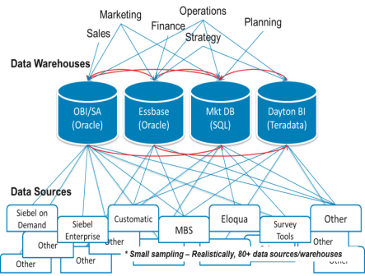
Pre Fido – State of Business Intelligence in LNRS
Myriad of different BI solutions deployed across the business
Disparate systems
Inconsistent data (multiple versions of the truth)
Incomplete view of a customer
Inconsistent data governance
Redundant functions across the business (analysis, blending, reporting)

Slide 4
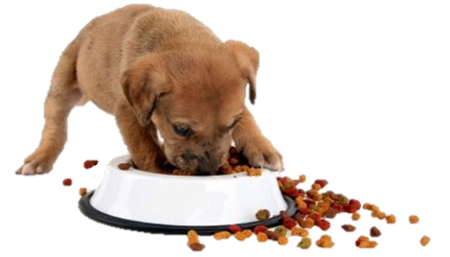

Fido BI Launch Purpose
Empower Our People With Knowledge
Maintain a single version of the truth
Data Driven Actionable Business Insights
Change the way the company makes decisions
Eat Our Own Dog Food
Fido supports organic growth by relying less on anecdotal and after-the-fact analysis and instead relying more on the numbers to drive actions
With Fido, a robust analytics capability has been established on a common foundation of “gold standard” data and processes to answer fundamental business questions such as: Which customers are at risk for leaving? Which leads should Sales work on? etc.
The Fido solution leverages best practices we use for our own products and uses HPCC as the master repository for that gold-standard enterprise data
The benefits have included new opportunities for innovation and growth and improved operational efficiencies
Notes:
For the past 2 years we have talked about Fido and now it is coming to life. Some of you have been a part of this initiative.
The initiative came about when we realized we are providing great value to our customers through data and analytics. Why are we not doing the same for our ourselves? Aka Eating our own dog food.
This initiative pulls together LN Risk customer data from different parts of the business: Finance, Customer Service, Marketing, Back Office. Across all of the businesses: Insurance, Business Services, and Government
The Fido objective is reaching beyond just LN Risk and into other businesses of REED such as Reed Exhibitions

Slide 5

Fido BI – Data & Process Governance
Fido Governance – standardize data definitions enterprise-wide to ensure quality, security and usability while still being agile to adjust to business needs
The key components of Fido Governance have included:
Define product hierarchies
Sustain product naming conventions
Maintain customer account attributes
Manage data definitions / data dictionary
Visualization standards
Control end user access levels
Optimize reporting tools based on needs of end users
Process defined for access, dashboard and enhancement requests
Core documentation
Fido: Accelerating Risk’s Organic Growth through Analytics

Slide 6







Fido BI – Results to the Business
Automation of Core Processes
Forecast engines for Finance, automated Revenue dashboards
How are we doing against deals closed (forecast vs. actual)?
Sales Pipeline, Marketing Campaigns, Leads
Pipeline Health, Campaign ROI, Lead Performance Mgmt, Operational Workflow
Product (usage / inquiry results) data and automated alerts
Robustly monitor performance by customer, product and geography
Timely early warning system for product volume drops, unusual spikes because of either unexpected customer actions, market changes, internal operational issues
Greater predictive analytics
What financial services products can we upsell to a Customer?
Which Customers are the best for us?
External customer dashboards: show customers the LN value add
What are my hit rates? What additional products can I buy to enhance hit rates?
How is the product performing for me vs my competitors/peers?

Slide 7

Fido BI – Results to the Business (continued)
Integrated Single Version of the Truth
Confidence in Financial and Operational Metrics
Greater collaboration across functions
Faster, more effective decision support
Shifting resources from data compilation to insights
Significant savings in manual labor across the organization
Timely identification of millions of dollars of potential revenue loss that business has been able to action on
Greater self service for end users
1,500 users across RBA, over 125 dashboards, thousands of reports, dozens of automated alerts, over 20 cubes, 5 forecast engines
University of Notre Dame Latin dictionary defines Fido as "to trust, believe, confide in" and several books on the origin of names defines Fido as meaning "I am faithful" ... which resonates with what Fido is to the organization

Slide 8







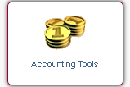


Data available in Fido
Innotas
Financial (Billing, Customer / Product Master)
Product Usage (Accurint, RWS, BNK, MVR, NCF, CLA, CLP, etc.)
RBI
(Sales Force CRM and Oracle Financials)
Corporate
(Cust / Sales Hierarchy, PeopleSoft, PCT, Royalty, etc.)
MyCRM
(Pipeline, Customer Operations, Go To Market)
Projects
(Tech Engg. Projects, Resource Demand / Capacity)
Marketing (Eloqua, NPS, MRM)
Firmographics
(D&B, Experian, LNCA, BIP)
Context Sensitive Data Linking & Utilization
Fido Enterprise Data Warehouse
Powered by HPCC

Slide 9
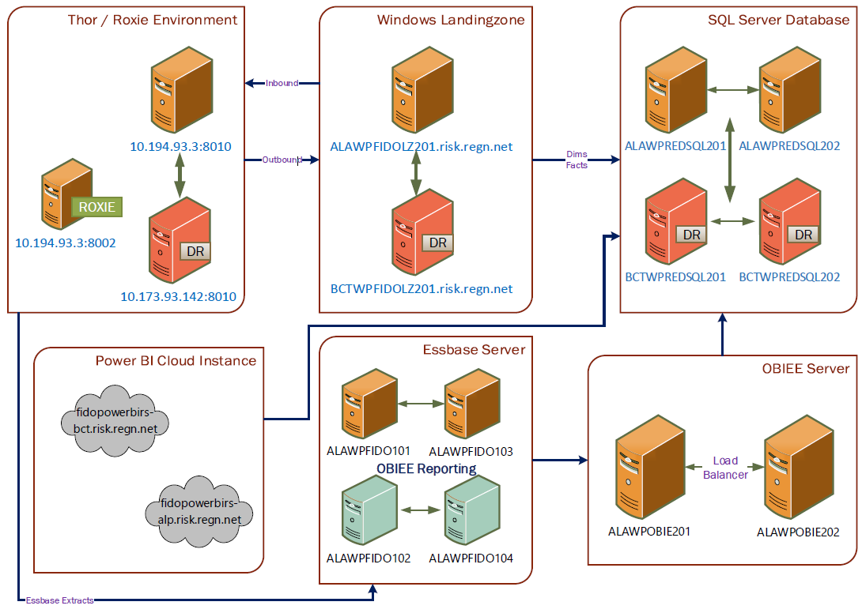
Fido Infrastructure

Slide 10
Fido Services Model
ETL Automation
Data Lake
Dimensional Modeling
Data Science
Visualization

Slide 11






Fido Services
Data Engineers | BI Engineers | Data Scientists
Fido Data Environment
Landing Zone
Data Lake
Dimensional Model
Data Sources
Visualization
Data Science
ETL Automation
Data Governance | Data Curation | Data Security
Tools: HPCC, SQL Server, Essbase, Power BI, OBIEE, Python, R

Slide 12
ETL Automation Services
Handles scheduling and system integration for the purposes of ingesting source data
Transformation of data for the purpose of storing, integrating and disseminating information
Based upon a combination of HPCC and Python
HPCC/ECL transforms data across our data environment
Python acts as glue, scheduling jobs and integrating with other systems
With HPCC, Fido handles many big data problems efficiently … and is also equally adept at handling non big data use cases

Slide 13
Data Lake Services
Repository of data stored in its natural format
Can contain structured and semi-structured data
Based on HPCC, currently requires ECL programming to access data
Current users include product and technology
Potential future utilization of Spark to broaden access and capabilities
Fido also has deployed snapshot modeling to solve various uses of tracking slowly changing values over time

Slide 14
Dimensional Modeling Services
Data structured into star schema based fact and dimension tables for the purpose of end user analysis
Structure supports powerful and effective handling of complex data analysis queries
Dimension conformity can be achieved across multiple sources of data to build relationships that cross data sets
Based on SQL Server, data can be accessed by SQL, Power BI, etc.
Due to HPCC / ECL and concept of dynamic schema binding, the Fido dimensional model design remains agile to meet fast moving complex business needs

Slide 15
Data Science Services
Goal: Drive actionable business insights based upon data and analytics to effectively change the way the company makes decisions
Methods:
Use predictive analytics such as logistic and linear regression to predict future customer behavior such as attrition
Augment human monitoring / human intelligence with systematic alerts and insights
Analyze trends and identify outliers efficiently and effectively
What set us apart:
All predictions and alerts from the analytics are completely automated and results are delivered through dashboards updated daily

Slide 16
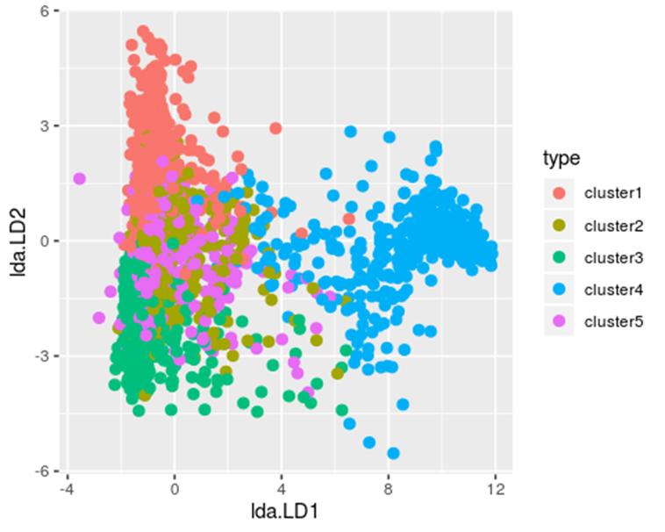
Data Science Services Utilize data for analytics – alerts & segmentation
Insurance Alerts – Created suite of alerts based upon Fido data
Customer usage decline
Positive usage spike
Customers’ potential breach of contract
Missed Price Change
Customer Behavior Segmentation & Migration – One of the best ways to understand customer behavior is to study customer migration patterns

Slide 17
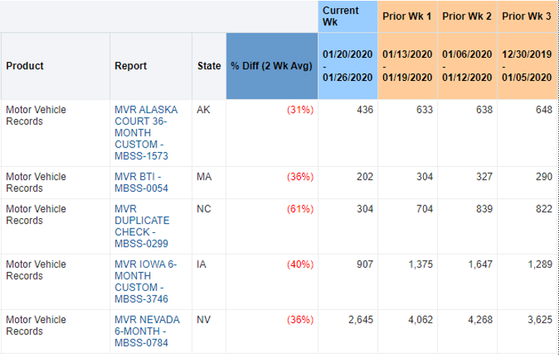
Data Science Services Alerts Example Dashboard
Decline in Customer Usage
Company: 03241

Slide 18
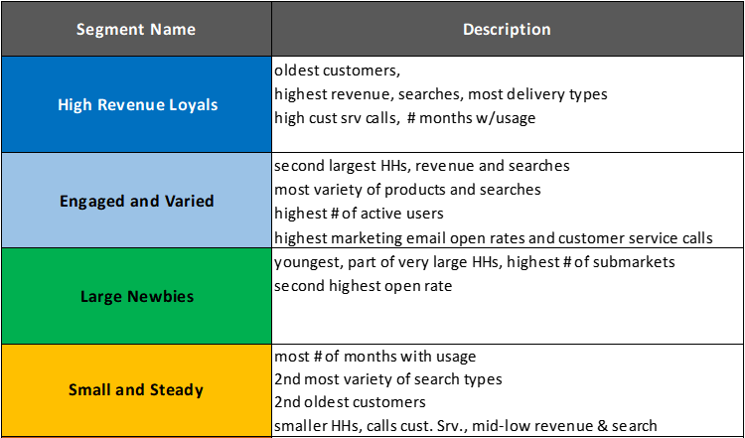

Data Science Services Behavior Segmentation

Slide 19
Visualization Services
Designed to deliver actionable insights and analytics to the business
… in the form of
Reports and Dashboards
Canned
Interactive
With Power BI, greater ability to self service
OLAP Cubes
Adhoc data mining
Forecast Engine
Automated financial calculations for Budget / RFs / Flash

Slide 20
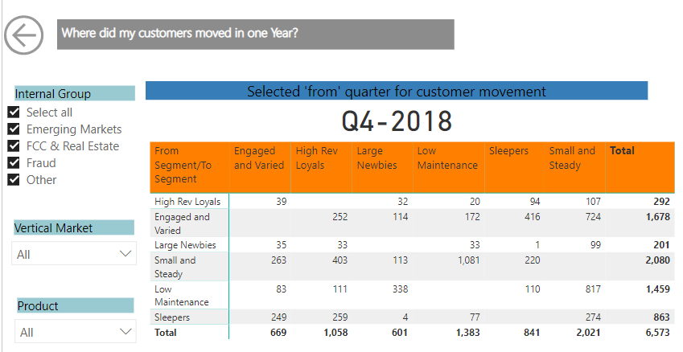
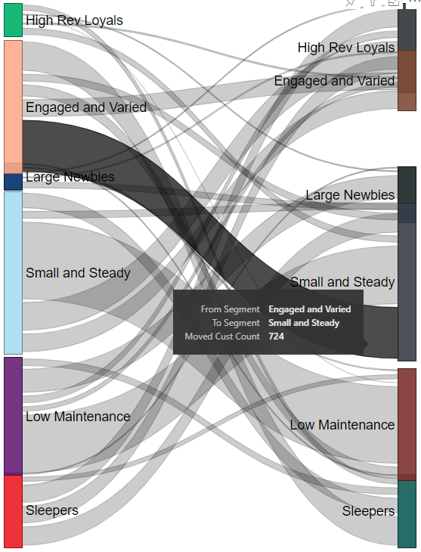
Visualization Services Dashboard Example

Slide 21

Future Technology Considerations
Use of HPCC-SPARK integration
Potential use of Cloud technologies to increase Fido’s compute & storage capabilities / capacity

Slide 22

Brainstorming

